Slide 1
RentHelpMN:
Program Overview
March 30, 2021

Slide 2
Federal Assistance now available for renters
$375 Million State of Minnesota Allocation in the Consolidated Appropriations Act, issued December 2020
Program can pay back rent and forward rent, utilities and some other housing expenses.
Each household is limited to 15 months of assistance.
American Rescue Plan funds are forthcoming
  Longer timeline for the number of months covered and how long the program will be available.
Notes:
In the federal stimulus bill that passed in December, Congress made $25 billion available across the country to help stabilize renters and rental markets.
Almost $400 million of that came to Minnesota – to the state, to 7 local governments, and to 9 Tribal Nations.
You may have heard that another $25 billion passed in the American Rescue Plan in March of 2021.
If so, that is correct, but we are waiting on information on that program so can’t say much – the good news is that we’re sure it’s more funding to help more renters for a longer period of time.

Slide 3

Core Values of
Human Centered: Use strategies to reach those that might otherwise be left behind – geography, ability, language.
Anti-racist: Use intentional strategies to not perpetuate the conditions that create and maintain racial disparities.
Customer experience: Minimize stress and uncertainty.
Transparency, timeliness and flexibility.
Critical partners for equitable outcomes: Engage organizations led by and working for communities most impacted.
Notes:
Minnesota Housing and our partners in local government have set out from the beginning to create a program that reaches all who need the assistance.
We have heard your feedback about the program we operated in 2020 called COVID-19 Housing Assistance Program and have made improvements in efficiency and communication to renters and landlords.
We are following these core values from the start of RentHelpMN:
To make the program human centered, using strategies to reach those that might otherwise be left behind.
To be anti-racist, using intentional strategies to not perpetuate racial disparities.
To focus on the customer experience to minimize stress and uncertaintly.
To be transparent, timely, and flexible.
To engage critical partners to equitable outcomes by working with groups that are led by and work for the communities most impacted by COVID.

Slide 4
Website is now live at
.org
Notes:
Before we move into more detail I would like to introduce you to the website for RentHelpMN.
This website is now live at RentHelpMN.org – that’s “RENT HELP M N dot O R G“
I’ll walk through the steps to apply and the other resources available.

Slide 5
Next Steps: How to Apply
www.RentHelpMN.org to “Apply Here.”
Renters are able to apply online and upload their documents.
If preferred, a paper application is also available, which can be downloaded and printed or requested by mail.
Landlords can also create an account, register their properties, and coordinate with renters to initiate an application on the renter’s behalf.
Notes:
Here’s a quick overview of how you will apply for RentHelpMN.
You will be able to apply online at RentHelpMN.org.
When RentHelpMN is ready to take applications, there will be a button on RentHelpMN.org to “Apply Here.”
You will be able to apply online and upload your documents.
If you prefer, you will be able to apply with a paper application, which you will be able to download and print or request by mail.
Right now is the time to Get Ready. The program is not open for applications yet but will be soon.

Slide 6
Who is eligible?
Renters with low or moderate incomes who have been impacted by COVID-19 and face housing instability.
Those are eligible for other government programs like Food Stamps, MFIP or General Assistance are likely eligible for RentHelpMN.
Assistance is for renters below 80% of Area Median Income (moderate income) who have been financially impacted by COVID-19 and face housing instability.
Notes:
It is important to note that this assistance is only for renters. Homeowners are not eligible per the federal rules –we know that homeowners are also struggling in the pandemic and we hear you. We hope to know more about how federal stimulus dollars might help homeowners with mortgages and utilities soon. But, from the federal government this program, RentHelpMN, is for rent and renters only.
COVID-19 impacts include increased costs, loss of work, reduced hours, financial strain from caring for children while schools were closed, financial strain of health challenges and other stresses of the pandemic. The reality is that these circumstances are true for many renters right now and that’s why we are facing a housing crisis.
Housing instability means either the renter is at risk of eviction or being forced to move. Or the renter isn’t confident that they can make their rent payments in the future.
We know that it’s hard to communicate income levels using these acronyms. If you know that you access some government programs such as food stamps, MFIP, General Assistance and your income hasn’t gone up recently it’s likely you would qualify under RentHelpMN. The same goes if you live in affordable housing where you income qualified for your apartment.
Otherwise, the lowest income level we would serve is in Aitkin County in Minnesota where 1 person earning $40,700 or below would qualify and the highest is in the metropolitan area where 1 person earning $54,950 and 4 people living on $78,500 would qualify. If you are on the edge of those requirements call 211 for help. We will have some more resources up on our website soon.

Slide 7
Public Housing and HCV Participants
Renters receiving housing subsidies (e.g. public housing residents or housing choice voucher recipients) can apply for the tenant portion of their rent payment
RentHelpMN payments should not be calculated as income
Public Housing and HCV participants are not eligible for prospective rent payments. They should request a recertification if their income goes down
NCSHA has developed a resource for public housing providers available at: https://www.ncsha.org/wp-content/uploads/ERAP_PIH_ERAP_FAQs.pdf

Slide 8
What kind of assistance is available?
Past-due rent, dating back to April 1, 2020.
Up to 3 months of forward rent at a time.
Up to a total of 15 months per household.
The tenant-paid portion of subsidized rents (Section 8, Public Housing, Housing Support).
Past due tenant-paid utilities.
Other housing expenses.
Housing expenses that are not covered by other programs.
Notes:
This assistance is tied to the pandemic and so we can cover rent and utilities back to March 13, 2020. Past due months and forward rent months add up to get to the total of 15 months. If you need the forward rent, make sure to request it when you apply
Additional assistance offered includes:
The tenant-paid portion of subsidized rents (Section 8, Public Housing, Housing Support).
Past due tenant-paid utilities.
Other housing expenses.
Housing expenses that are not covered by other programs.
Renters who apply and are approved would be processed for the maximum assistance available to them, or what they request – whichever is lower.
Initially the program will address back-due rent.
Once we are feeling good about clearing the backlog of renters with back rent we will open to all applicants, which will include renters who only need help going forward.

Slide 9
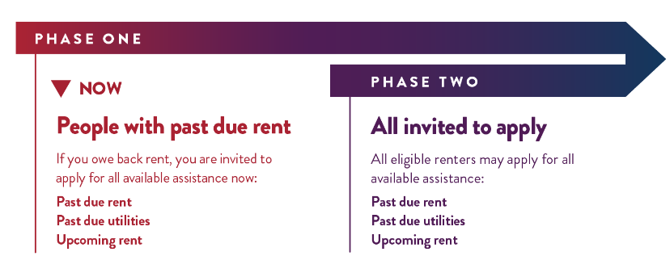
Who can apply now?
Notes:
Phase One is open to people that currently owe back rent, and are invited to apply for all of the assistance they need.
Phase two will open once we are able to process applications with back rent. We do not yet know when phase two will open.

Slide 10
Some paperwork is required.
Identification: Paperwork to show who you are.
Income: Documents that show your income.
Rent: Documents that show you have a rent agreement and how much you owe.
Bills: Documents that show your utilities and other housing-related costs.
Notes:
We have done everything we can do minimize the paperwork requirements but the rules are the rules and the federal government want to make sure we follow a few important policies.
We are looking for some form of identification, which can include state IDs from any state, Tribal IDs, IDs issued by other countries. We also need to confirm that your income is within the limits. If you file taxes a 2020 1040 for every adult is the fastest way to get this done. Or you might just have the forms such as 1099s and W2s. If you don’t have those, you can still show your income with documents such as pay stubs or a letter from certain government programs that test your income. In circumstances where an adult in the household truly has no income you will be able to sign to confirm that you have no income.
To show that you are a renter and have a rent obligation track down a copy of your lease. If you don’t have a lease, talk to your landlord now about getting a statement that they rent to you and for how much. If you don’t have a lease, for instance if you are living in a hotel or renting a room, we can still help. You will just need to work with 211 to figure out what documents will help us review your application.
Finally, so that we can make a payment we need to get copies of your bills. For past due rent, talk to your landlord about getting a ledger or statement of rent due. For utilities, track down unpaid bills and demand letters.
Signatures are digital, but the documents would need to be uploaded. Take pictures with your cell phone or get help with scanning if you want to apply online. You will want to get organized and get help if you need it to submit a fully completed application. If the application is missing materials we will need to follow up, causing delays, and every day counts when you are waiting for assistance.

Slide 11

If you have questions or need help getting ready
Call
OR: Toll Free: 800-543-7709
211 can help answer your questions when you are applying or preparing to apply.
211 offers language services and accommodations and can help with paper applications.
Notes:
When you call 211, you will reach a highly trained service professional who can answer questions about the renters’ application.
211 offers assistance in many languages and offers accommodations. They can help whether you apply online or on paper and mailed in.

Slide 12
Support for applicants
Field Partners and Community Partners are available to assist. Call 211 to get connected.
The full application is available for online viewing and for printing.
Paper applications will be mailed to upon request.
Status updates will be provided at RentHelpMN.org.
Remember: To avoid processing delays, take the time to submit a complete and accurate application.
Notes:
We want every eligible renter in need to get this help. We know that online applications don’t work for everyone and we get it that the documentation requirements alone can present a barrier. So we are doing everything we can with our partners to support renters to get access to this assistance.
If you are comfortable with computers and have access to the internet, the online application is set up to be reasonably intuitive.
But we really want you to get that application in and submitted so we can get to work reviewing it. So we have built in support.
Your first line of communication is 211.
If you don’t know where to start, call 211.
Maybe you are applying online but don’t understand one of the questions in the application and you call 211 so you can keep moving. The government partners in RentHelpMN have pulled together dozens of community organizations to take the time 1 on 1 with some renters needing culturally specific assistance or an extra push to get the materials together. Start with 211 or reach out to your usual support networks.
And maybe it’s easiest for you to fill in a paper application, make copies of your documents at Kinkos and mail it all in. We will make paper applications available through 211, downloadable on the site, and through community partners.
We know that waiting for help when your rent is late is stressful and even more so when you don’t know when the assistance will come through. The online application includes status updates you can use to communicate with your landlord or with our processing teams at the program if they have further questions. The 211 and Field Partner resources are also set up to assist.

Slide 13
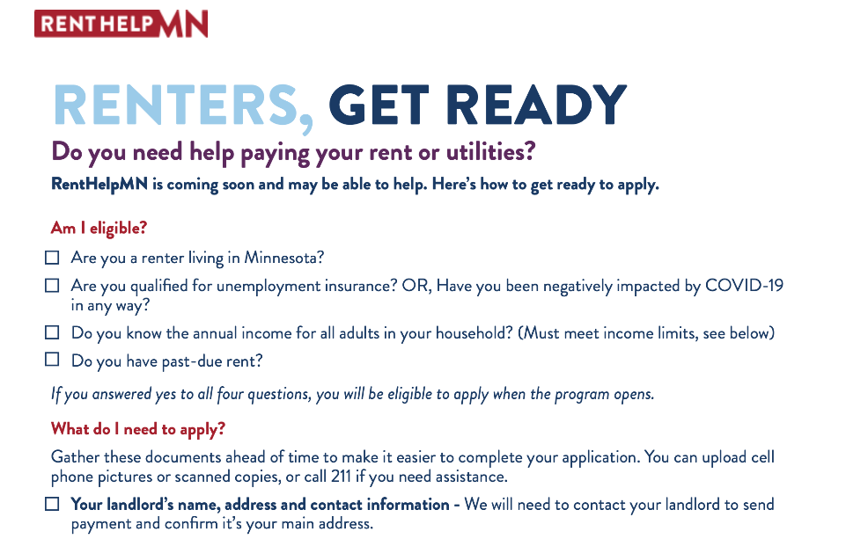
Notes:
The Renters: Get Ready Checklist, shown here, is now available for download on the RentHelpMN.org website.
The two-page document has a list of the materials you will want to start collecting npw as you prepare to apply.
This checklist will encourage you to reach out to your landlord to get the most recent copy of your rent agreement or other information. It will tell who what kind of income documents you can track down to be ready to apply.
It also answers some frequently asked questions.

Slide 14
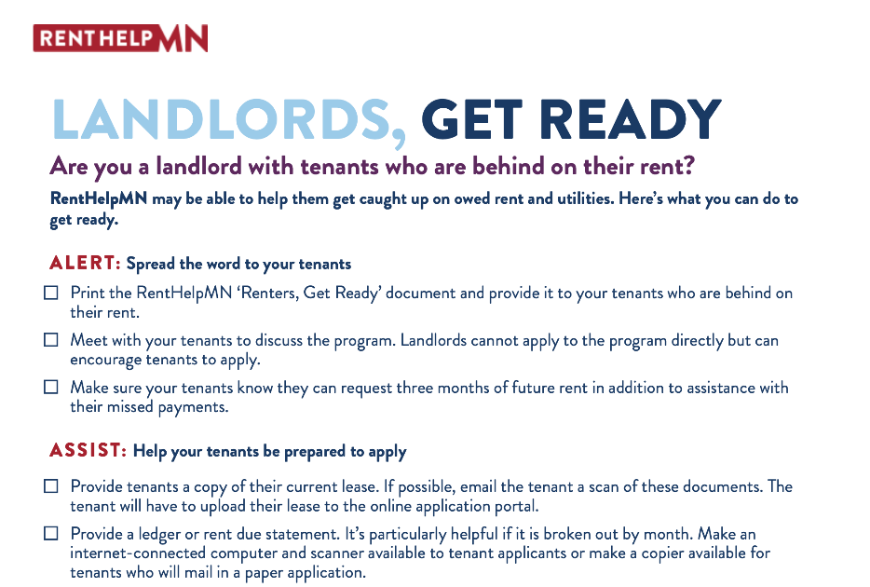
Notes:
The “Landlords, Get Ready” checklist, shown above, is also available now on the RentHelpMN.org website.
To the landlords listening today, you can be some of the best partners for your tenants in helping them get ready. This checklist encourages you to do three things:
Alert your tenants of RentHelpMN.
Help your tenants be prepared to apply. And
Get your portion of the documentation ready.
A big part of the application is bringing documents that show the household is responsible for rent as well as their back rent due. You can make sure they have the most up-to-date paperwork in hand, or even email the documents if that works for the tenant.
If you have the resources, you can also help your residents prepare and submit their complete applications. Maybe that’s a computer, internet, printing and scanning. Or getting some paper applications for residents who aren’t comfortable working online.
You also will want to get ready yourselves! As businesses, you will want to be ready to upload your W9 and other information on your business. And for larger management companies, talk to your staff about who will take the lead on setting up and managing accounts in the online system. Some larger managers may want to use a central office staff person to organize everything, others may want to have site managers set everything up.

Slide 15
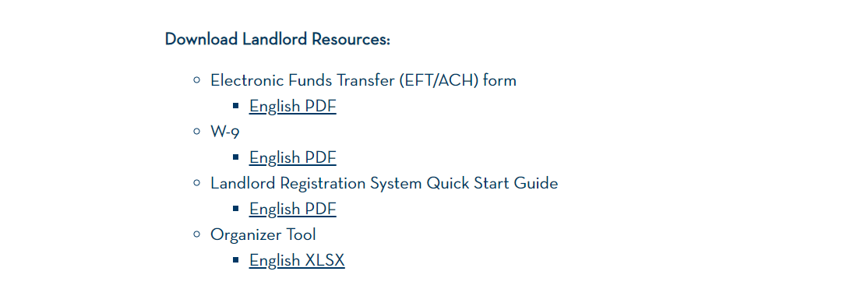
Resources for Property Owners & Managers
Notes:
I’ll be highlighting a few tips and tricks, but I also encourage you to click the “Resources” tab and scroll down to the “Download Landlord Resources” section. The Landlord Registration System Quick Start Guide provides a detailed step-by-step tutorial for how to get started and how to link with renters’ applications.

Slide 16
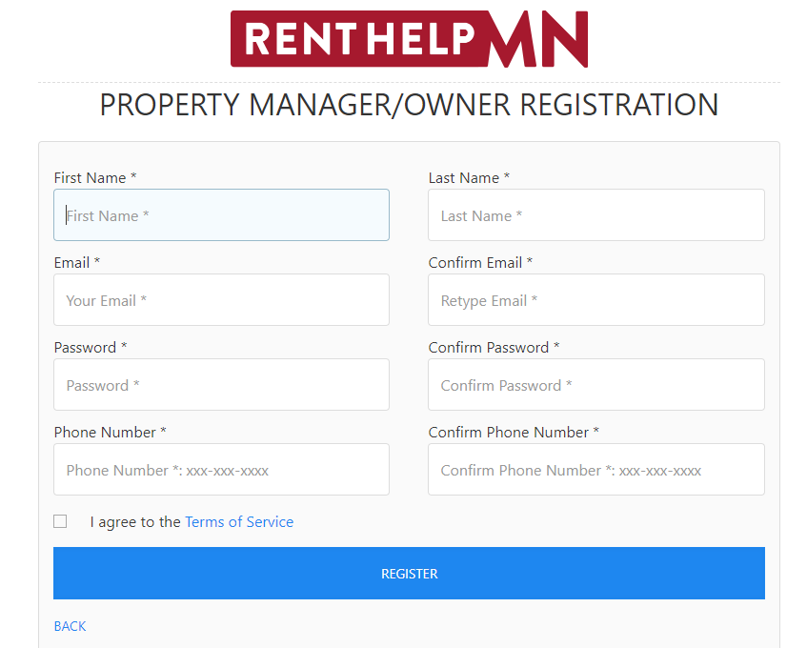
Property Owner/Manager Actions
Complete the Property Owner/Manager Registration
Link properties to their account
Mark "agree" to the terms of agreement to be able to see the applications associated with the property address.
When notified, review and approve renter’s application for assistance

Slide 17
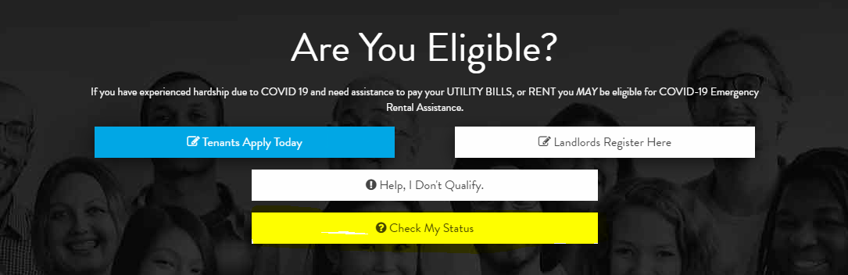
Checking Application Status
RentHelpMN.org, click “Apply” to go to the Application Page
Property Owners/Managers will see applications assigned to their address
Call 211 (Renters) or email Landlords@renthelpmn.org to reset your login
Notes:
Renters and Landlords can go to the application page from RentHelpMN.org at any time and click “Check My Status”
Status Updates include common ones like:
Pending Initial Review – The team has probably skimmed through to see if your application is complete
Requires Applicant Response – Hopefully you saw an email or got a call asking you to update something or answer a question on the application
Initial or Final Review – We are working on it
Withdrawn – You requested this or the application sat too long with no activity
Declined – You are not eligible, but maybe can reapply or appeal – check with the team
And a few others
Username and Password
Did you forget it? Didn’t write it down? – Call 211 and they can put in a ticket request to the program team to send you a login reset

Slide 18
Property Owners/Managers: Streamlining the Process
Review the Organizer Tool resource on the RentHelpMN.org site and consider assigning a single point of contact for RentHelpMN to simplify and streamline W-9 and owner information
Request payment directly deposited into the bank account via Automated Clearing House (ACH) rather than a paper check

Slide 19
Help spread the word about
NOW: Help people Get Ready:
Share the link to RentHelpMN.org with a
“Get Ready” social media message
Share the Renter and Landlord Checklists
Share “Apply now” social media posts
We’ll have a flyer, poster, website banner
Text messaging language
Email messaging
Materials are available in four languages.
Notes:
If you’re here because you want to support your neighbors, friends, members of your faith community, or your tenants, we encourage you to share the materials from the RentHelpMN.org website.
Currently these include the “Renters, Get Ready” and “Landlords, Get Ready” checklists.
Once we are open for applications, we will have a social media campaign covering all of the popular platforms and we hope you will share the messages far and wide.
We’ll also make other marketing materials available for you to share, including a flyer, poster, website banner, text messaging language and email scripts. The materials will be available in English, Spanish, Hmong and Somali.
And now I’d like to turn it over to Commissioner Ho.

Slide 20
Common Questions
If an application is approved, who will receive the payment?
The payment will be made to the landlord, but if the landlord does not provide the necessary information within a required timeframe, the payment will be made to the renter?
Can landlords apply without the tenant?
Landlords can initiate an application process, but the tenant will need to provide income verification and sign the application.
If a renter is unemployed or has received rent help in the past, can they apply?
This program is different than other emergency assistance programs. People that are unemployed or have previously received rental assistance can apply as long as it is for rent that is still owed.
What languages are available for the application, information, and assistance?
The application and informational materials are translated to Hmong, Somali, Spanish. They will also be translated into Oromo and Karen. Both 211 and our Field Partners providing outreach and application assistance speak multiple languages and can also obtain interpreters.
How long will it take to issue payment?
Our centralized application and payment processing systems will allow efficient processing of a high volume of applications, but we do not yet have an estimate. Status updates are available at RentHelpMN for the renter, their authorized assistant, and the property addressed owned by landlords.
Notes:
For questions about immigration status:
“All eligible renters living in Minnesota may apply. We will not request, and are not required by the federal guidelines to request, any immigration status documents. Household members must demonstrate eligibility based on income, COVID-19 impact, and risk of housing instability. However, wherever verification of income, impact, and risk is required we will provide multiple options for demonstrating eligibility and field partners will be trained to assist households seeking assistance.”
Likely questions from lawyers:
Will this process be quick enough to resolve payment for someone in the eviction process? Is it unlikely that payment would be issued, but status updates would allow the renter to show that they have applied.

Slide 21
Questions & Answers
March 30, 2021

