Slide 1
Emergency Housing Vouchers
Michele Smith, Field Office Director,
Minneapolis HUD Field Office

Slide 2
American Rescue Plan of 2021 Emergency Housing Vouchers
Section 3202 of the ARP appropriated $5 billion for:
New incremental emergency housing vouchers (EHVs)
Renewal funding for the EHVs
Admin fees for administrative costs and other eligible expenses defined by notice
EHVs targeted to homeless, at risk of homelessness, fleeing domestic violence/dating violence/sexual assault/stalking/human trafficking, and recently homeless
Sixteen PHA’s in Minnesota selected to receive these vouchers
HUD Notice PIH 2021-15

Slide 3
PHA in and for the City of Minneapolis | 246
METROPOLITAN COUNCIL | 218
Public Housing Agency of the City of St Paul | 157
DAKOTA COUNTY CDA | 50
HRA of DULUTH, MINNESOTA | 49
HRA of ST. CLOUD, MINNESOTA | 48
HRA of WORTHINGTON, MINNESOTA | 17
NW MN MULTI-COUNTY HRA | 16
HRA of BEMIDJI, MINNESOTA | 15
HRA of PIPESTONE, MINNESOTA | 15
MANKATO EDA | 15
KOOCHICHING COUNTY HRA | 15
CLAY COUNTY HRA | 15
MORRISON COUNTY HRA | 15
DOUGLAS COUNTY HRA | 15
RICE COUNTY HRA | 15

Slide 4
Allocation Formula
Designed to direct emergency vouchers to PHAs in areas where eligible populations have the greatest need
Took into account PHA capacity
Tried to ensure geographic diversity

Slide 5
PHA’s Acceptance of Vouchers
Must inform HUD by Monday, May 24
Can accept a lower number of vouchers (minimum is 25 or 15)
May subsequently be contacted by HUD to accept or decline additional EHVs if additional EHVs become available because other PHAs declined their allocation

Slide 6
Voucher Eligibility
EHV eligibility is limited to individuals and families who are:
Homeless;
At risk of homelessness;
Fleeing or attempting to flee domestic violence, dating violence, sexual assault, stalking, or human trafficking; and
Recently homeless, as determined by the Secretary, and for whom providing rental assistance will prevent the family’s homelessness or having high risk of housing instability.
Definitions found on pp 16-21
Notes:
Recently homeless: Participants in Rapid Rehousing and PSH (Move On)

Slide 7
Recently Homeless
Notice specifically calls out participants of “rapid re-housing” and “permanent supportive housing”
Rapid Rehousing - a housing model that uses short-term tenant-based rental assistance (up to 3 months) and/or medium-term (for 3 to 24 months), to help a homeless individual or family, move as quickly as possible into permanent housing
Permanent Supportive Housing – housing for homeless households where at least one adult or child has some disabling condition such as substance abuse disorder, mental illness, etc. Supportive services are provided and there is no limit to length of stay
“Move Up” or “Move On” concept also mentioned in relation to this category of eligible participants

Slide 8
Continuum of Care Partnership
Required partnerships with the Continuum of Care (CoC) and other organizations for direct referrals and services (Pgs. 22-24)
PHAs must work with community partners to determine the best use and targeting for EHVs along with other resources available in the community.
PHAs must enter into a Memorandum of Understanding (MOU) with their community’s CoC to establish a partnership for the administration of the EHVs.
All referrals for EHVs must come through the CoC’s Coordinated Entry (CE) System or from a Victims Services Provider
CoCs are responsible for determining whether the family qualifies under one of the four eligibility categories for EHVs.

Slide 9
Continuum of Care
A local or regional planning body responsible for coordinating the funding and delivery of housing and services for people experiencing homelessness in its service area
Organizations within the CoCs receive funding through the Continuum of Care Program, which is designed to promote a community-wide response to ending homelessness

Slide 10
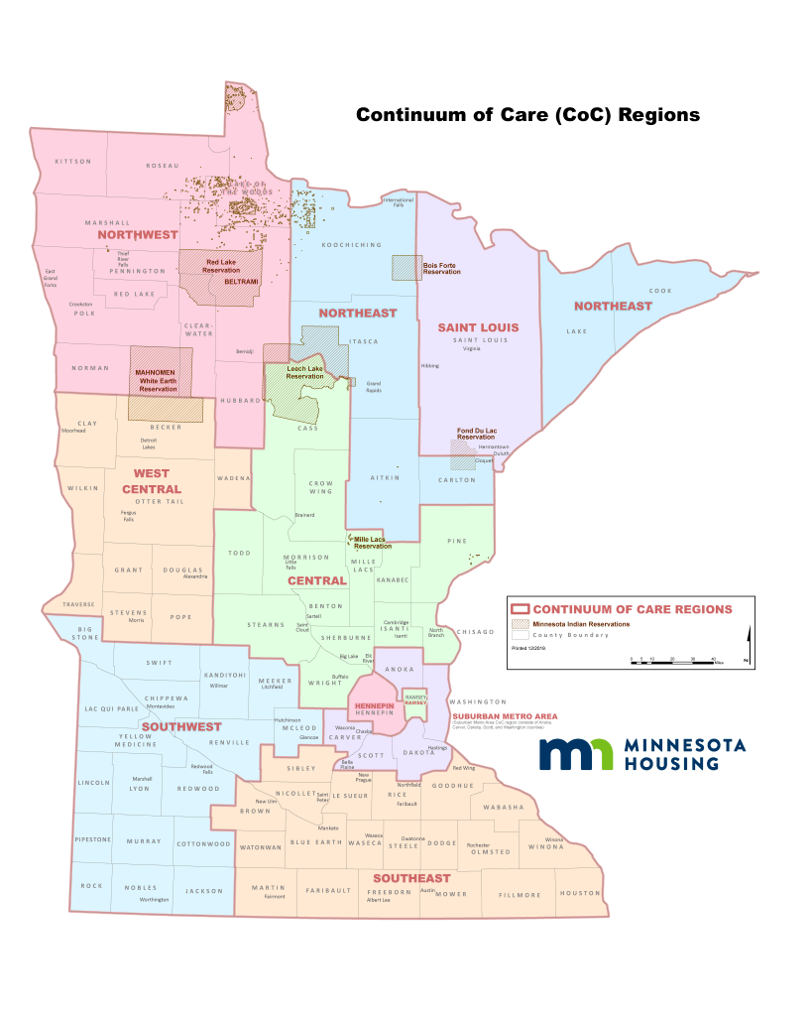
CoC Regions Map

Slide 11
Continuum of Care Contacts
Continuum Name | Contact | Email Address
Minneapolis & Hennepin County | Laura DeRosier | Laura.derosier@hennepin.us
St. Paul & Ramsey County | Loni Aadalen | loni.Aadalen@CO.RAMSEY.MN.US
Rochester & Southeast | Jennifer Prins | jprins@threeriverscap.org
Dakota, Anoka, Scott & Carver Counties (SMAC) | Abby Guilford | abby@mesh-mn.org
Northeast | Patty Beech | pattybeechconsulting@gmail.com
St. Cloud & Central | Tim Poland | tpoland@cmhp.net
Northwest | Cory Boushee | coryb@nwmf.org
Moorhead & West Central | Carla Solem | h2hcoordinator@gmail.com
Duluth & St. Louis County | Courtney Cochran | CochranC@StLouisCountyMN.gov
Southwest | Justin Vorbach | justinv@swmhp.org

Slide 12
MOU Requirement
PHAs accepting an allocation must enter into an MOU with a partnering CoC “within 30 days of the effective date of the ACC funding increment for EHVs” (beginning on 7/1/2021)
An MOU must be established no later than 7/31/2021
Sample MOU is found in Attachment 2 of the Notice
Notes:
HUD will be facilitating an MOU workshop

Slide 13
Fees
Eligible Fees | Fee Type | Calculation
 | Preliminary Fee | PHAs will be awarded $400 per allocated EHV (Page 8).
 | Issuing Action Fee | PHA will earn $100 once the voucher is initially leased, if the PHA reported the voucher issuance date in the Public Housing Information Center-Next Generation (PIC-NG) system within 14 days of the later of the effective date of the family’s voucher or when the system becomes available for reporting (Pgs. 8-9).
 | Placement Fees | $500 for each EHV family placed under a HAP contract within 4 months of effective date of the ACC funding (beginning on 7/1/2021). $250 for each EHV family placed under a HAP within 6 months after the effective date of the ACC funding (beginning on 7/1/2021) (Pgs. 9-10).
 | Ongoing Administrative Fees | Full Column A Admin Fee Amount (Pg. 10).
 | Service Fees | $3,500 per allocated EHV (Page 10-14).
Notes:
Preliminary fee, Placement Fee, and Issuing Action fees: Admin costs or Service Fee costs

Slide 14
Services Fees
Services fee (the amount is $3,500 multiplied by the number of allocated EHVs)
Eligible uses include:
Housing search assistance
Security and utility deposit assistance
Owner recruitment and outreach
Owner incentive payments
Other expenses such as moving costs, essential household items, and tenant-readiness services
Notes:
Does not need to be tracked by voucher

Slide 15
Required Housing Search Assistance
At a minimum must include:
Identifying potential units
Transportation assistance
Conducting owner outreach
Assisting with competition of rental applications and PHA forms
Help expediting EHV leasing process
Notes:
PHA can contract out for these services. Should work with CoC

Slide 16
Housing Stabilization Services
A new Minnesota Medical Assistance benefit to help people with disabilities, including mental illness and substance use disorder, and seniors find and keep housing
Two of the eligible uses of Service Fees are “billable” through Medicaid in Minnesota: Housing Search Assistance and Tenant-Readiness Services
Can also bill Medicaid for “Housing Sustaining” services that are NOT eligible under the Services Fee
Minneapolis Field Office working to set-up a training for EHV PHA’s

Slide 17
HAP Funding
Initial funding term runs to 7/1/2021 to the end of Calendar Year (CY) 2022
Renewal funding term is on a CY basis
Renewal funding based on actual costs, similar to HCV, but renewal funding may be adjusted during the CY for increased costs, etc.
HAP and Admin fee funding is restricted to EHVs (similar to Mainstream)

Slide 18
Voucher Turnover
After 9/30/23, PHAs may not reissue EHVs when assistance ends (Section 13)
An EHV that has never been issued may be initially issued and leased after 9/30/23
Notes:
“HUD may direct PHAs administering EHVs to cease leasing any unleased EHVs if such action is determined necessary by HUD to ensure there will be sufficient funding available to continue to cover the HAP needs of currently assisted EHV families.” p. 42

Slide 19
Waivers and Alternative Requirements
Covid-19 Waivers (Pg. 22)
Separate waiting list for EHVs referrals/applicants (Pg. 27)
Local Preferences established by the PHA for HCV admissions do not apply to EHVs (Pg. 28-29)
Restrictions on PHA denial of assistance to an EHV applicant (Pgs. 29-32)
Income Verifications at admission (Pgs. 33-34)
Eligibility Determination: Social Security Number and Citizenship Verification (Pgs. 34-35)
Notes:
Still mandatory: Convicted of Manufacture of meth in fed housing; Lifetime registered sex offender; Waiving third party verification requirements

Slide 20
Waivers and Alternative Requirements, cont.
Inapplicability of Income Targeting Requirements (Pg. 34)
Use of recently conducted initial income determinations and verification at admissions (Pg. 34-35)
Pre-inspection of HQS units (Pg. 35)
Initial Search Term (Pg. 35)
Initial Lease Term (Pg. 35-36)
Portability (Pgs. 36-38)
Payment Standard Amount (Pgs. 38-39)
Notes:
Income determinations made under other programs within six months can be accepted; Initial search term increased from 60 days to 120 days; lease terms can be less than 1 year; payment standard up to 120%

Slide 21
Reporting requirements
New HUD reporting system (PICNG) to be used to collect tenant-level data from the HUD 50058. Expected to be available during summer 2021. Meanwhile PHAs required to collect and maintain HUD 50058 ("PIC") info for EHV participants.
HUD will also collect PHA-level program utilization data in the Voucher Management System (VMS).
HUD planning to issue a Notice covering EHV Reporting and will host a webinar in mid-June (tentatively June 23) to discuss any questions/concerns PHAs may have .
Technical assistance will be available to support PHAs in adopting the new PICNG system.

Slide 22
Technical Assistance and Resources
HUD is rapidly launching technical assistance (TA) to support communities through the implementation of EHVs
A series of webinars designed to aide participating communities will be offered via HUD Exchange
Additional support via Group Learning, On Call and Direct TA will be available to participating communities
HUD established a website dedicated to provide information on the EHV program (www.hud.gov/ehv)
HUD is also establishing a call center – details coming soon

Slide 23
Questions?
www.hud.gov/ehv
ehv@hud.gov
Michele Smith
michele.k.smith@hud.gov
(202) 903-9912

