Slide 1
COVID Communications: Messaging & Opening as We Transition to the New Normal
Nicholas Kelley, PhD –Public Health Administrator
May 20, 2021

Slide 2
What is Public Health
Public Health Definition:
Public health is what we, as a society, do collectively to assure the conditions in which people can be healthy.
The Future of Public Health, 1988 Institute of Medicine

Slide 3
Local Public Health Duties in MN
MN statute 145A defines the duties of community health boards, which are to:
Assure an adequate local public health infrastructure
Promote healthy behaviors and healthy communities
Prevent the spread of infectious disease
Protect against environmental health hazards
Prepare for and respond to disasters, assist communities in recovery
Assure the quality and accessibility of health

Slide 4
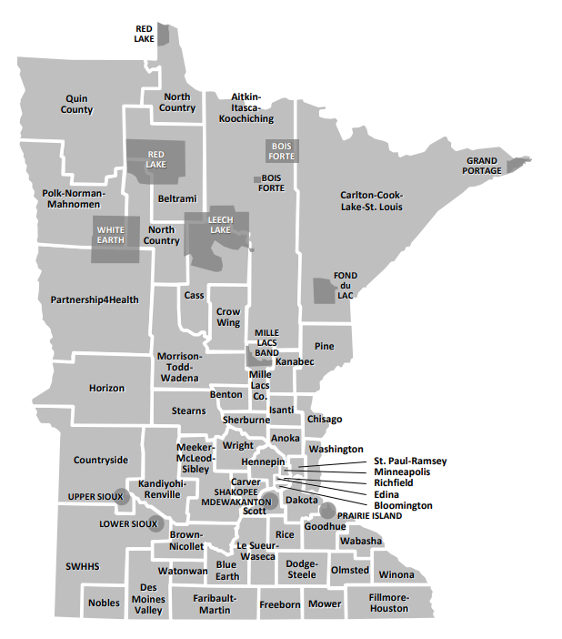
Community Health Boards

Slide 5
Factors that determine health
Tarlov AR. Public policy frameworks for improving population health.
Ann N Y Acad Sci 1999; 896: 281-93.

Slide 6
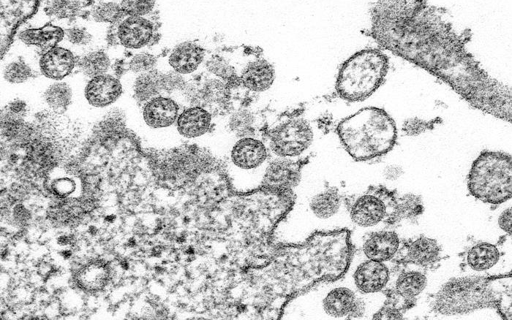
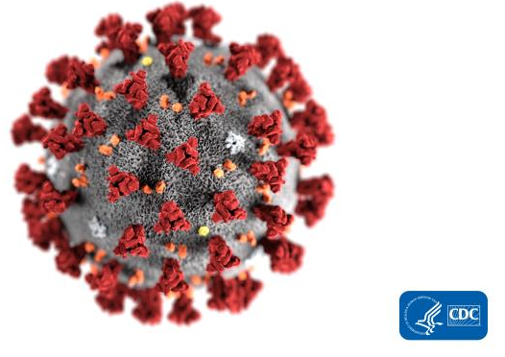
SARS-CoV-2
CDC/ C.S. Goldsmith and A. Tamin
Alissa Eckert, MS, Dan Higgins, MAM

Slide 7
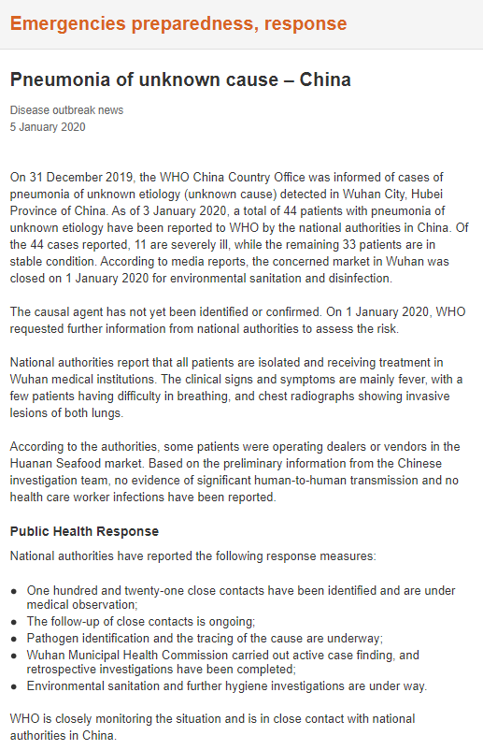

Slide 8
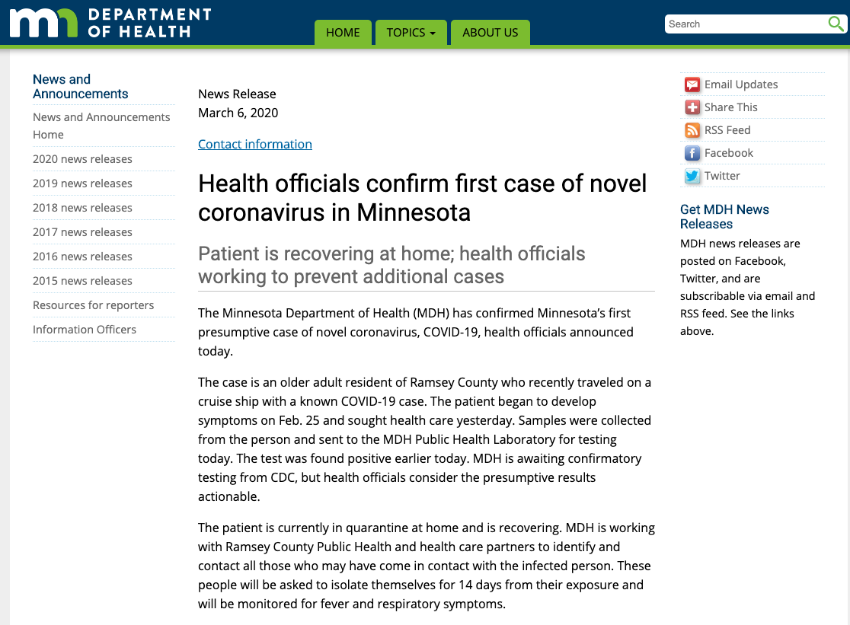

Slide 9
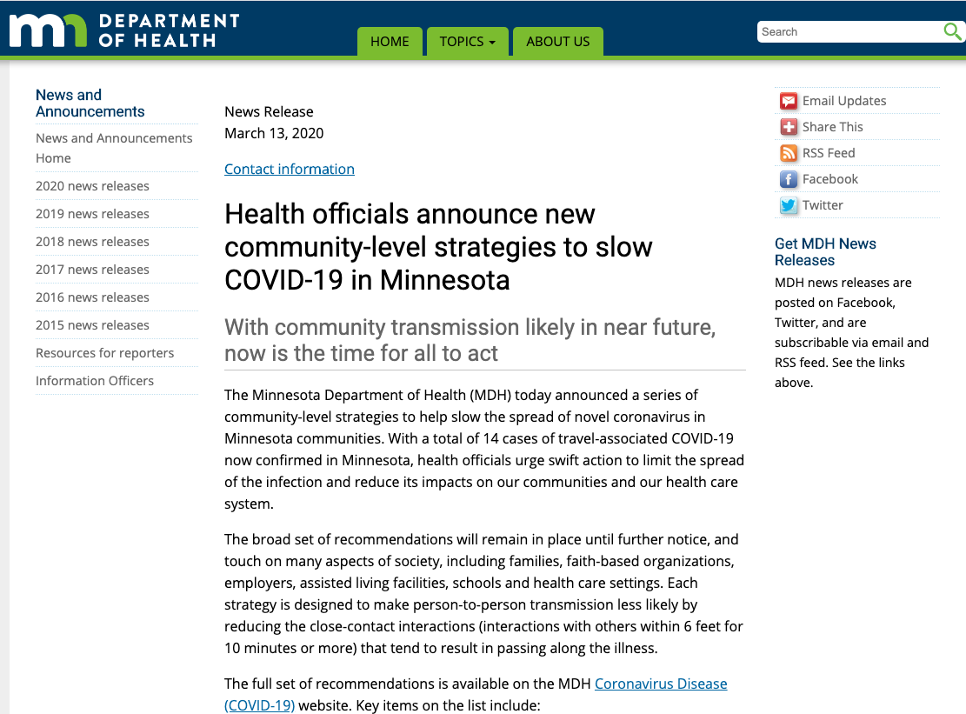

Slide 10
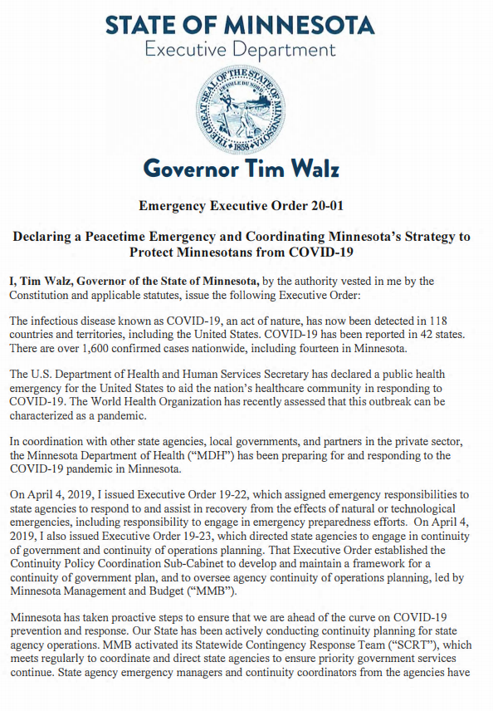
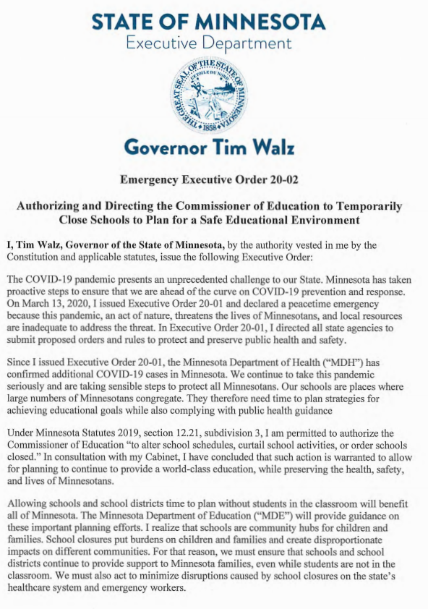
March 13, 2020
March 15, 2020

Slide 11
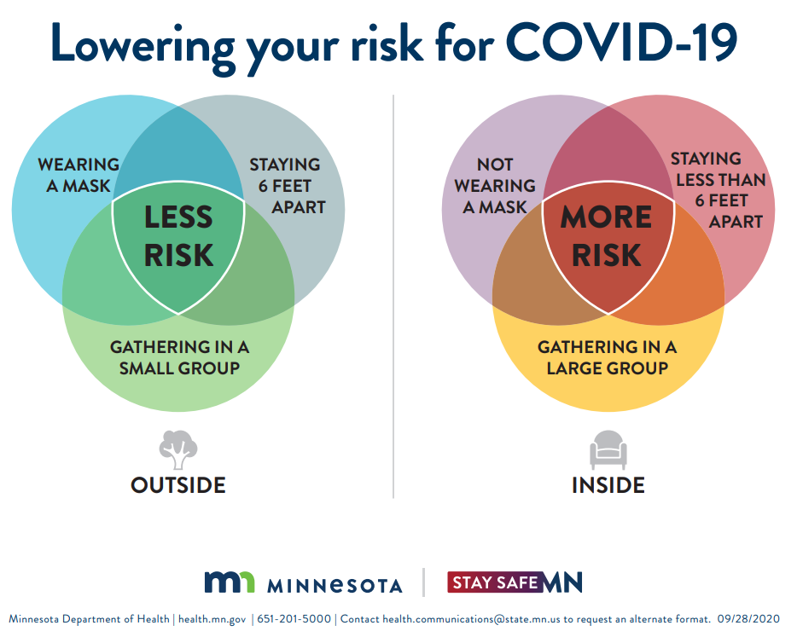

Slide 12
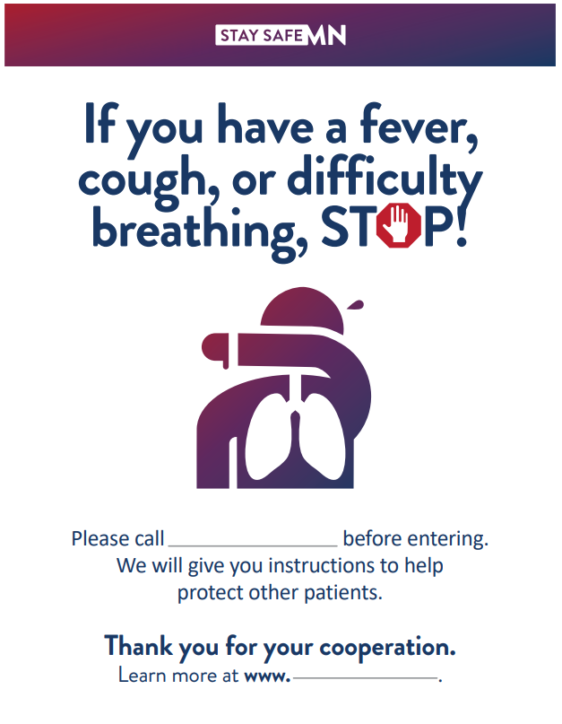

Slide 13
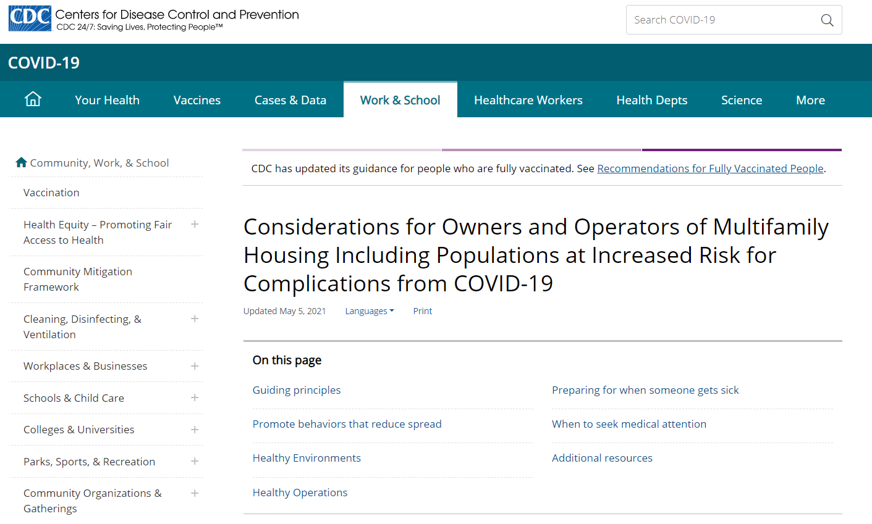

Slide 14
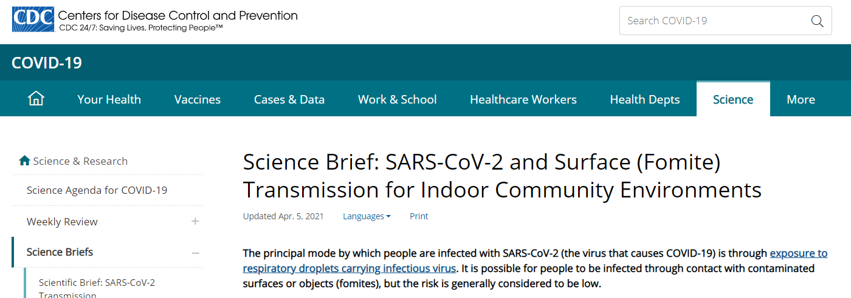
“People can be infected with SARS-CoV-2 through contact with surfaces. However, based on available epidemiological data and studies of environmental transmission factors, surface transmission is not the main route by which SARS-CoV-2 spreads, and the risk is considered to be low. The principal mode by which people are infected with SARS-CoV-2 is through exposure to respiratory droplets carrying infectious virus. In most situations, cleaning surfaces using soap or detergent, and not disinfecting, is enough to reduce risk. Disinfection is recommended in indoor community settings where there has been a suspected or confirmed case of COVID-19 within the last 24 hours.”

Slide 15
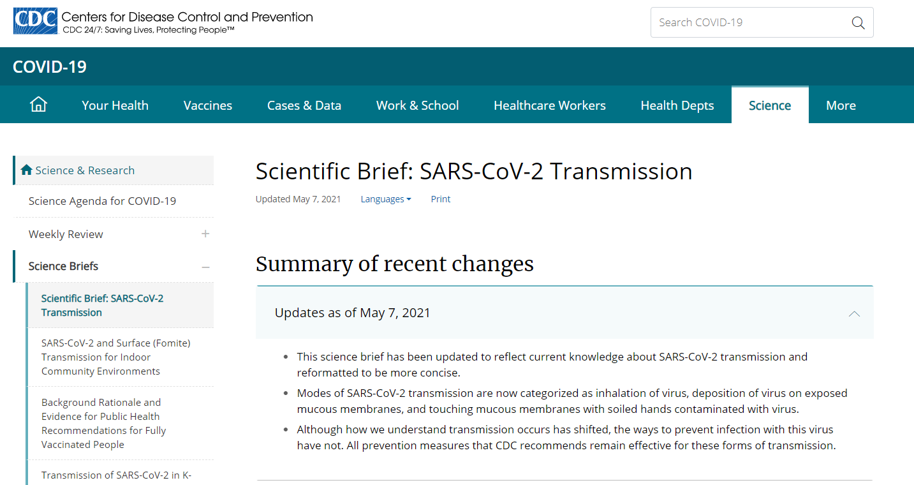

Slide 16
“COVID-19 vaccines currently authorized in the United States have been shown to be efficacious and effective against SARS-CoV-2 infections, including asymptomatic infection, symptomatic disease, severe disease, and death. These findings, along with the potential for reduced viral load in vaccinated people who develop COVID-19, suggest that any associated transmission risk is likely to be substantially reduced in vaccinated people. While vaccine efficacy against emerging SARS-CoV-2 variants remains under investigation, preliminary evidence suggests that the COVID-19 vaccines presently authorized in the United States will likely be effective against emerging variants,…”

Slide 17
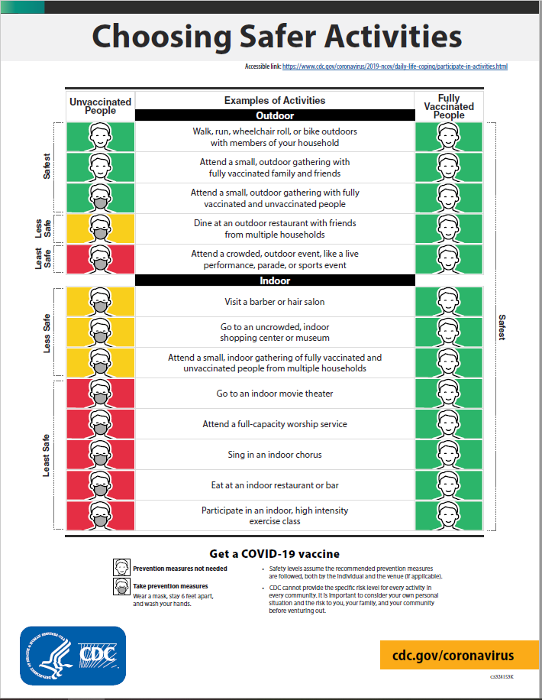

Slide 18
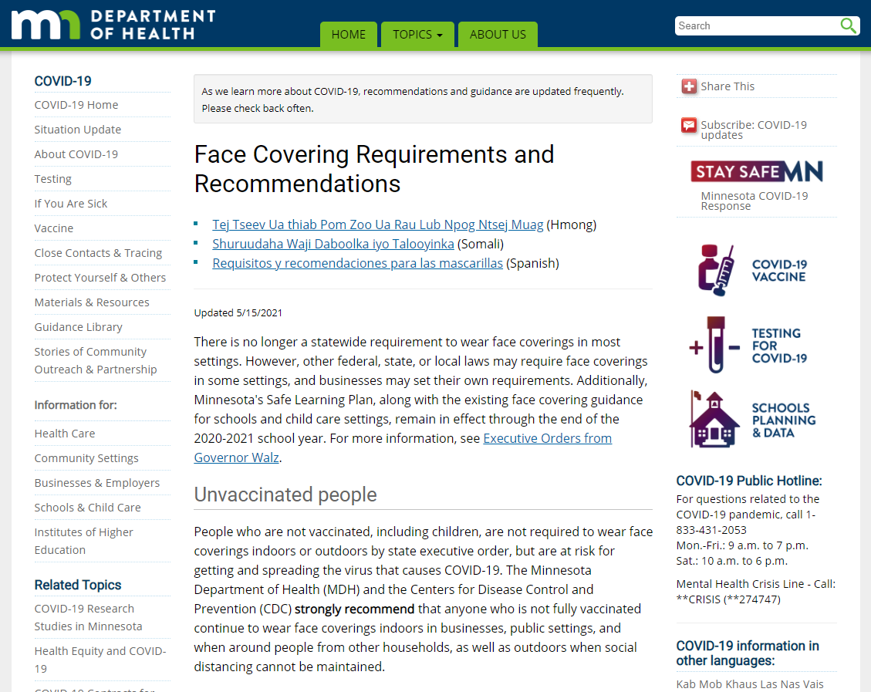

Slide 20
Vaccines
Register for the MN Vaccine connector:
Online: mn.gov/vaccineconnector
Call: 1-833-431-2053
Request a bus: https://www.health.state.mn.us/diseases/coronavirus/vaccine/bus.html
We have three incredible vaccines that are safe and effective
The best vaccine for you is the one offered

Slide 23
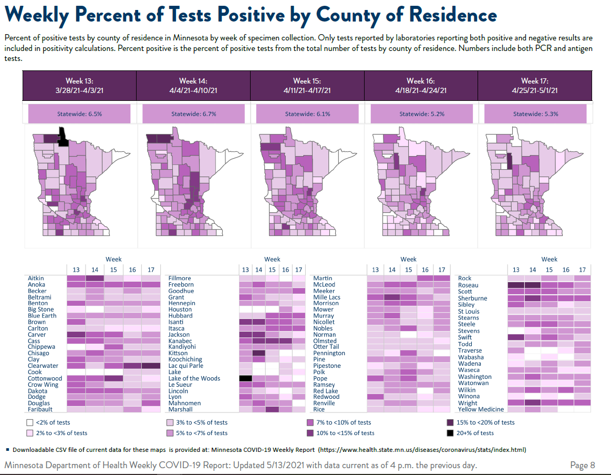

Slide 24
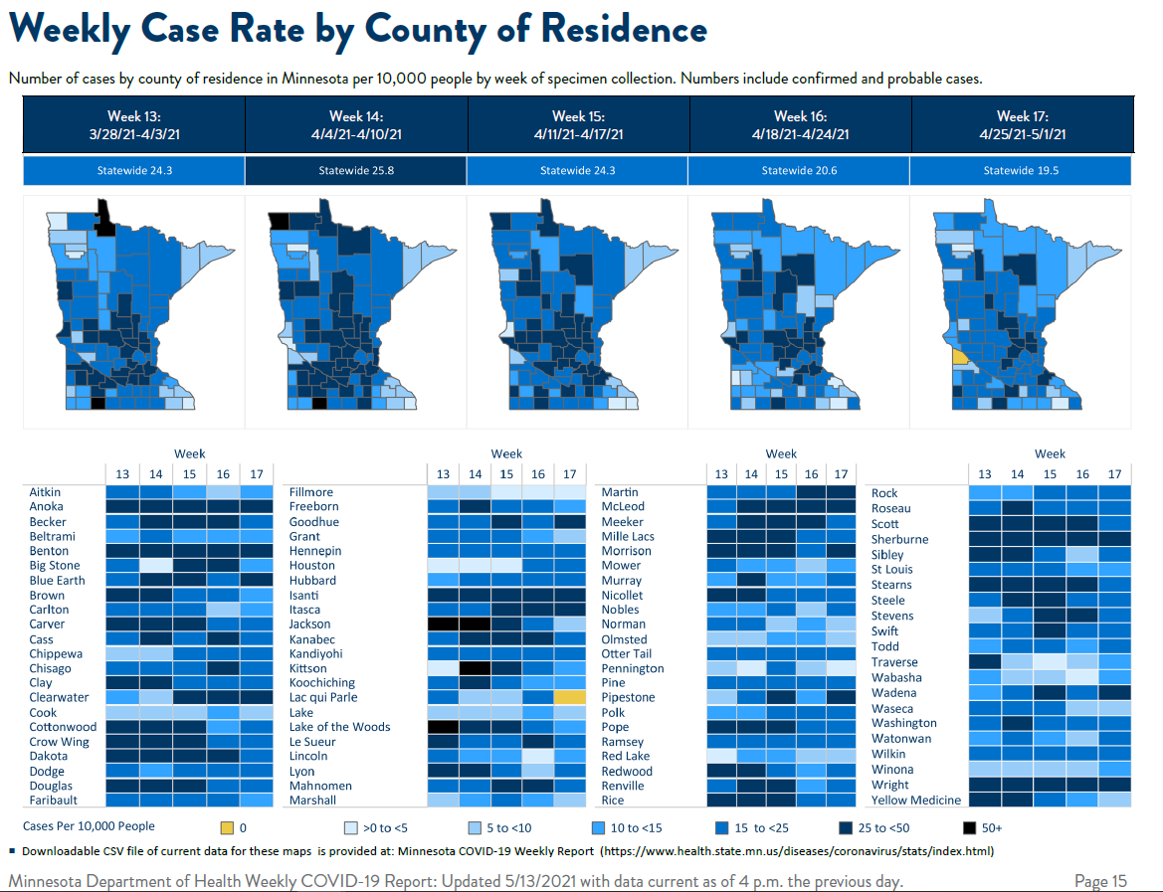

Slide 25
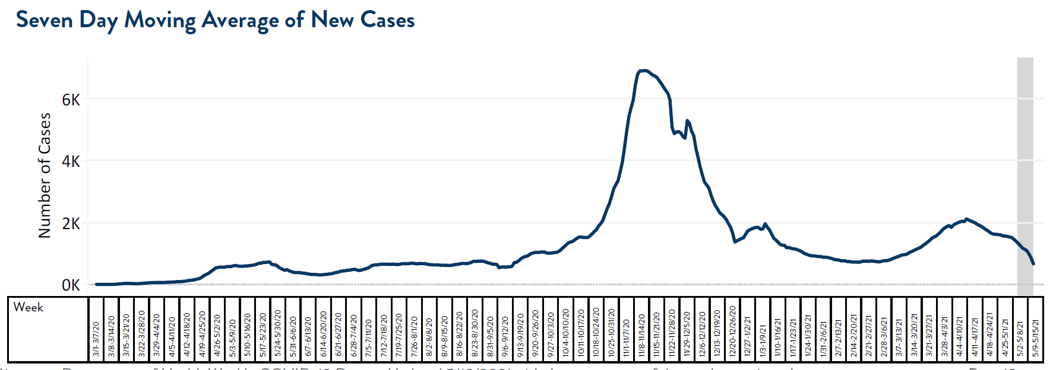

Slide 26
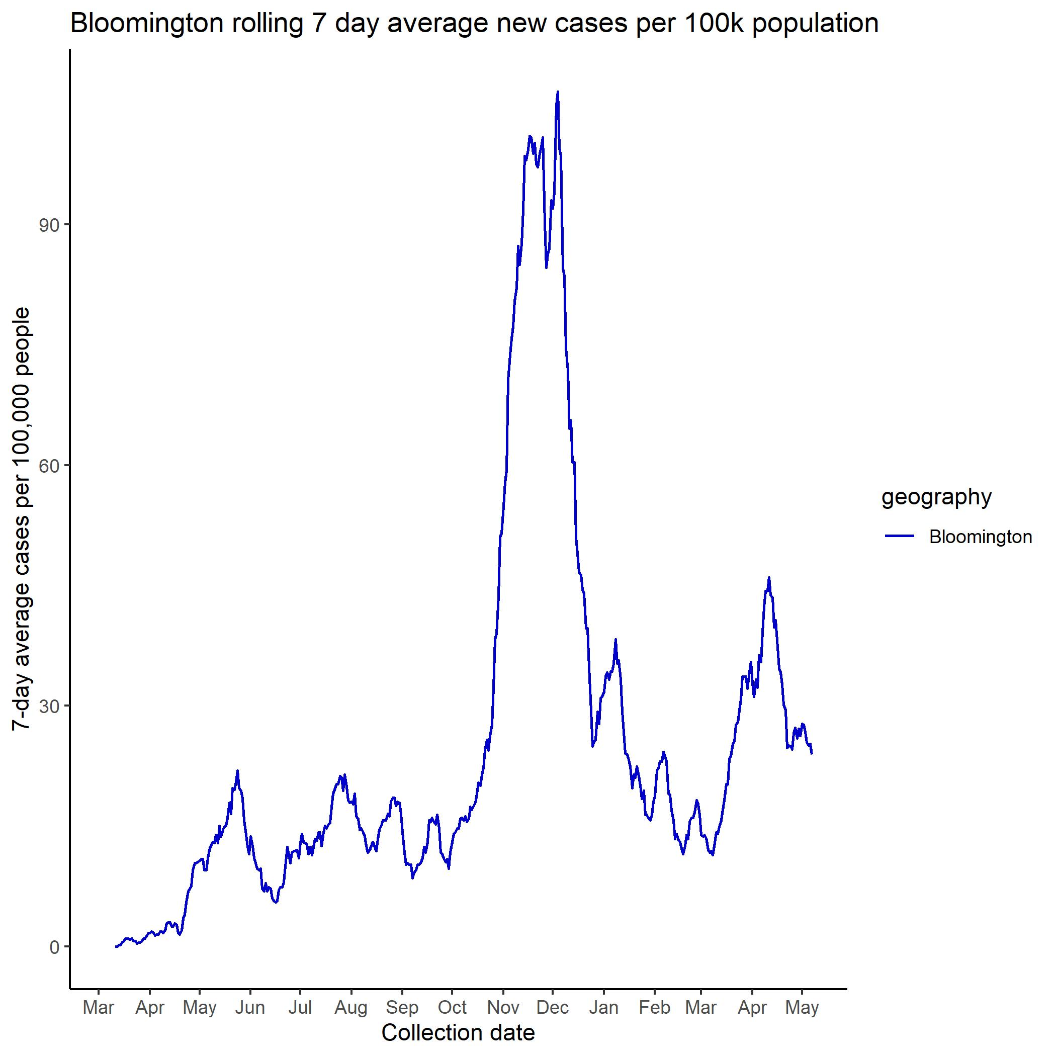
A - City Facilities Close
B – City Facilities Open
C – Mayor Declares Local Emergency
D – City Facilities closed
E – Vaccinations begin
M – Statewide mask mandate
M – Statewide mask mandate ends
D
C
E
Stay at home order
M
M
B
A

Slide 27
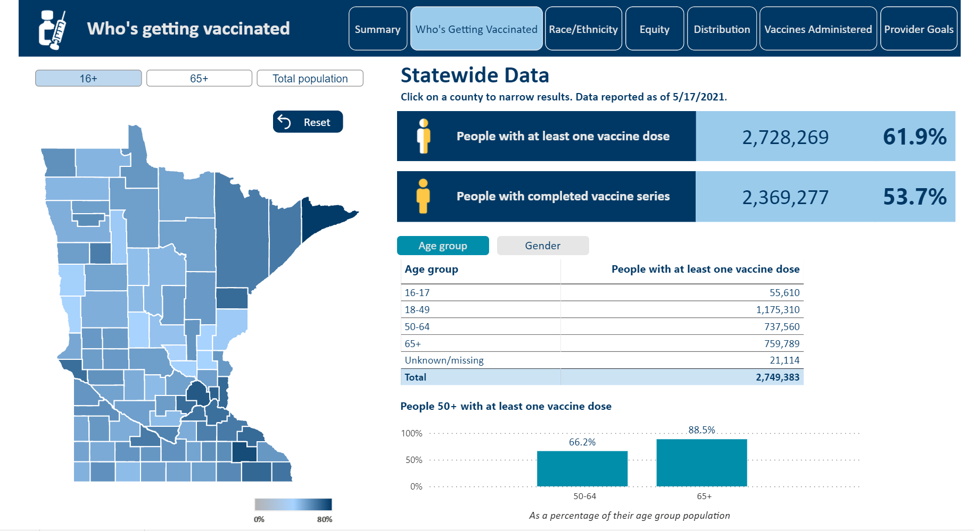

Slide 28
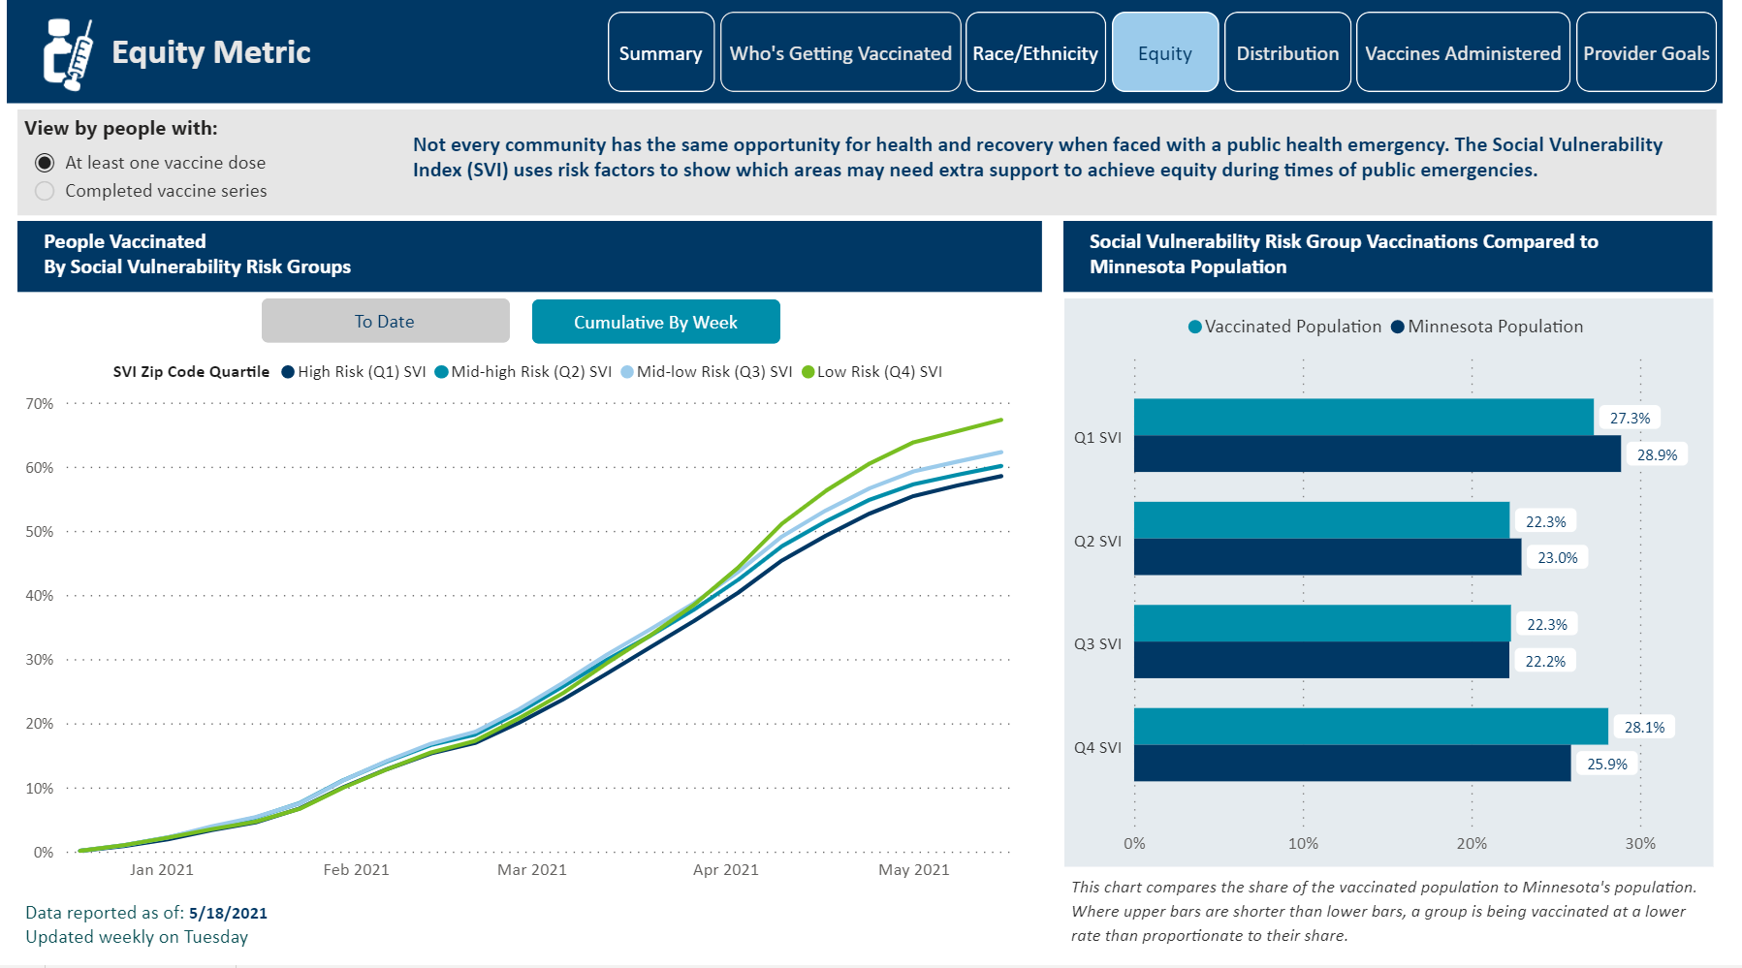

Slide 29
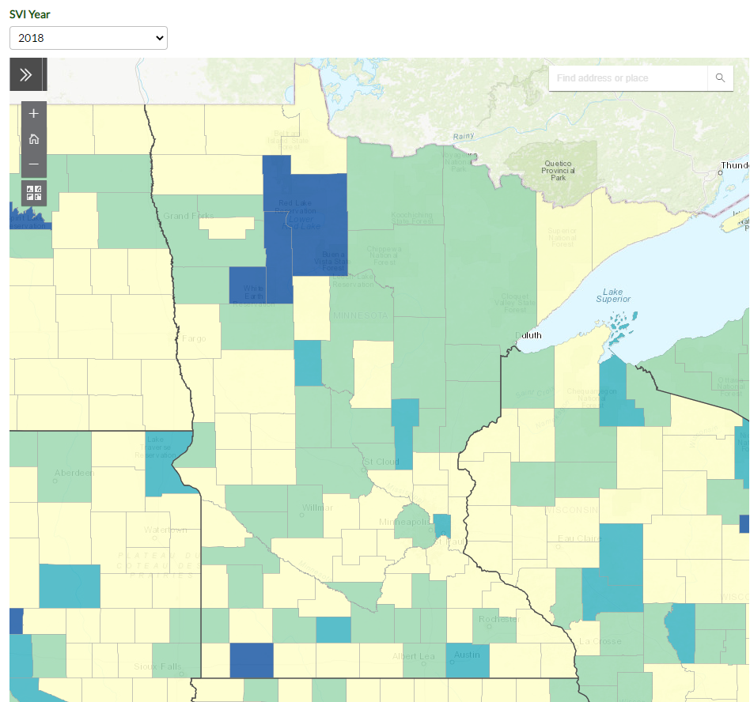
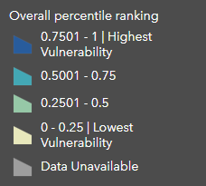

Slide 30
What is our new normal
We are still in a pandemic
Each day gets better here with increasing vaccine coverage and decreasing cases
We all process risk differently
Keep equity at the center
COVID-19 will eventually become endemic

Slide 31
Things to think about
Host a vaccine clinic at your building
Recognize the pandemic has been hard on everyone and amplified existing stressors.
Think about yourself, your team and your residents
Adjustments like this are change
Build or grow relationship with LPH or healthcare

Slide 33
Common Areas
Be confident in vaccination
Fully vaccinated can return to most things without masks per CDC
Think about users and your community
Who cant be vaccinated in our community
Follow local, state and federal guidance

Slide 34
Inspections
Be confident in vaccination
Things to consider
Consider your staff doing inspections
Consider your residents
Follow local, state and federal guidance

Slide 35
Cleaning
Think about how people catch COVID-19
Be confident in vaccination
Regular cleaning is important. Routine disinfecting not necessary in most situations per CDC for COVID-19.
Follow local, state and federal guidance

Slide 36
Communication Regarding COVID-19
Stay humble
Expect additional changes
Use trusted sources for info
Think about how they have adapted messages as the science changes
Have they corrected information they got wrong
Utilize the resources from CDC/MDH

Slide 37
Questions?
CDC/ C.S. Goldsmith and A. Tamin
Alissa Eckert, MS, Dan Higgins, MAM

